Slide 1
Secure Data Hiding in Image Using Steganography
CAPSTONE PROJECT
Presented By:
Student Name : DEEPENDRA
College Name & Department : SAGE UNIVERSITY BHOPAL
( BSc. FORENSIC SCIENCE )

Slide 2
OUTLINE
Problem Statement
Technology used
Wow factor
End users
Result
Conclusion
Git-hub Link
Future scope

Slide 3
Problem Statement
Description: Briefly describe the problem you are trying to solve. This could involve the need for secure communication, protecting sensitive information, or creating a hidden channel for messages without drawing attention.
Objective: What are you trying to achieve through the application? (e.g., hiding a secret message within an image for privacy or security.)

Slide 4
Technology used
Programming Languages: Python
Libraries/Frameworks:
OpenCV for image processing.
Tkinter for GUI interface (file dialog, display).
PIL (Pillow) for image manipulation and display.
cv2 for reading and writing images.
Techniques:
Steganography (hiding messages in images)
Basic encryption and decryption using passwords

Slide 5
Wow factors
Innovation: The concept of hiding messages in an image is interesting because it combines encryption with visual data.
Uniqueness: This method uses pixel-level manipulation, which is an attractive, fun, and creative way of securing a message in plain sight.
Engagement: The process of embedding and extracting a message in an image could be fascinating to end users, creating an interactive experience.

Slide 6
End users
Target Audience:
Individuals who want to securely hide messages.
Developers or hobbyists interested in learning about basic
encryption and steganography.
Security enthusiasts or privacy advocates.
Potential Use Cases:
Private communication.
Secure data transmission in less secure environments.
Fun for learning about image processing and cryptography.

Slide 7
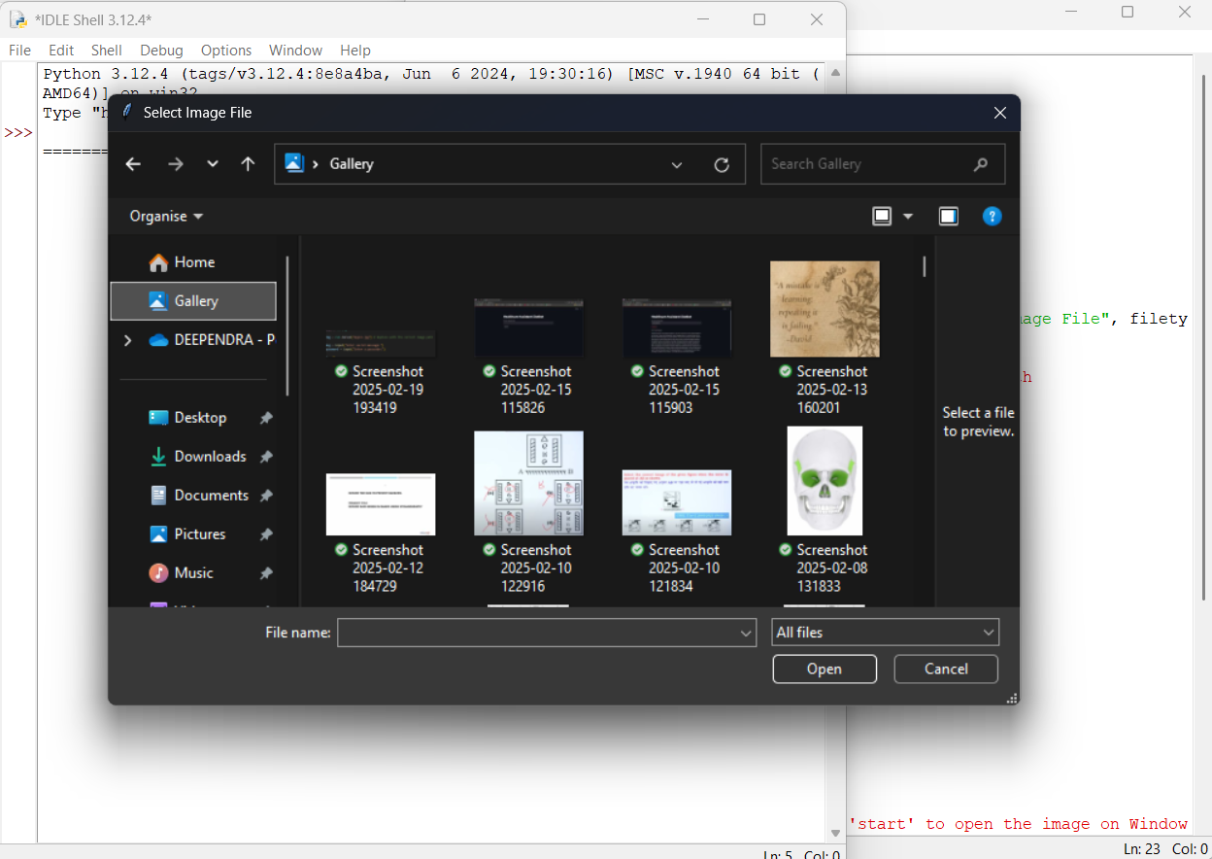
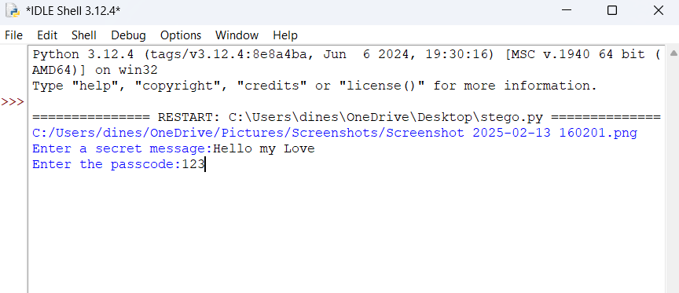
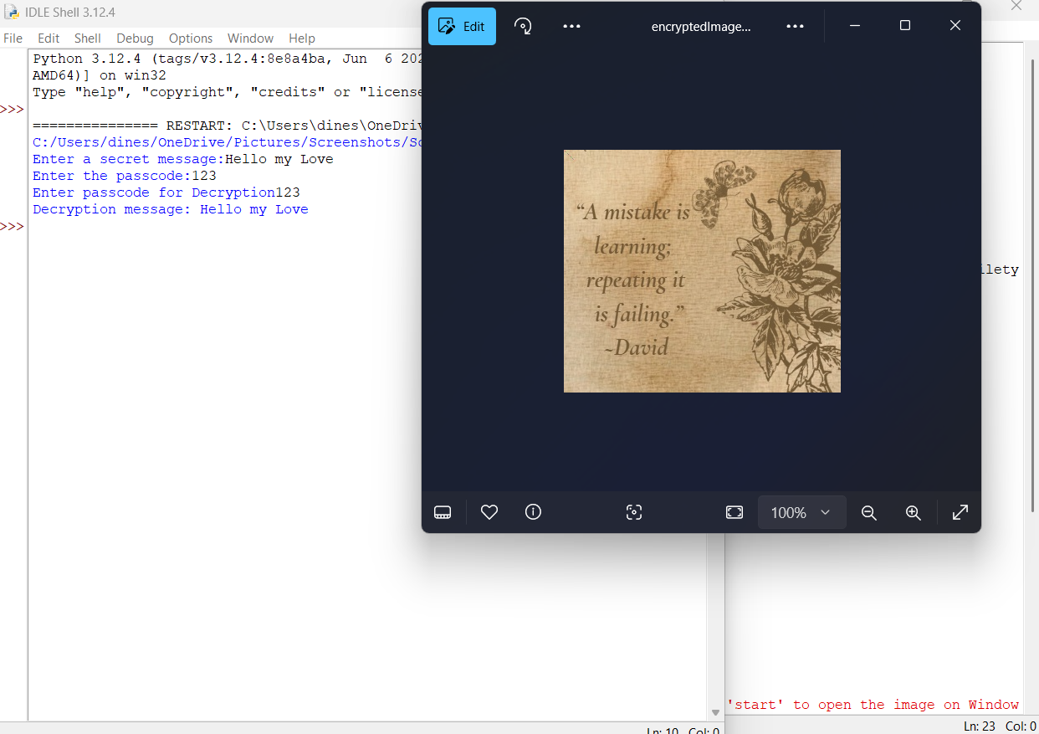
Results
Figure:1
Figure:2
Figure:3
Figure 1: Select Image from computer
Figure 2: Enter the secret message and passcode
Figure 3: New Image is created

Slide 8
Outcome:
A working application that allows users to hide and retrieve messages in images.
The process is demonstrated through encryption (modifying pixel values) and decryption
(restoring the message using a passcode).
Performance:
Image quality is impacted slightly, as pixel values are modified to store information.
Successful retrieval of the hidden message with the correct passcode.

Slide 9
Conclusion
Summary:
The project successfully demonstrates basic steganography by embedding messages in an
image.
It provides an easy-to-understand approach to image-based encryption using Python and basic
image processing libraries.
Achievements:
Learning about steganography.
Building an interactive GUI for the user interface.
Implementing a secure message hiding and retrieval system.

Slide 10
GitHub Link
https://github.com/DEV2DEEP/STEGNOGRAPHY

Slide 11
Future scope(optional)
Enhancements:
Use more advanced encryption algorithms (e.g., AES, RSA) to secure the message further.
Implement a more sophisticated GUI to allow users to visually interact with the process.
Allow for larger messages by optimizing image data storage (possibly using compression).
Integration:
Incorporate this method into real-world applications like secure messaging apps.
Explore embedding multiple layers of messages in an image or using other types of media
(audio, video).
Security:
Further secure the system by adding multi-factor authentication or implementing digital
signatures for integrity verification.

Slide 12
THANK YOU

